Slide 1
A brief introduction to biological data science and programming
Aislyn Schalck, PhD
(adapted from Frank Lenoir, PhD)

Slide 2
Who I am?
Former wetlab research assistant
GSBS BBSB/QS alum
TA’d Bioinformatics x2, Biostats x2 at GSBS
Currently Research Scientist at MDACC in Therapeutics Discovery
Mom x3

Slide 3
Why you should learn computational skills
Science is multidisciplinary – scientists should be too
Modern biology and medical research heavily utilizes large data
Basic computational skills improve your research efficiency
Expanded career opportunities

Slide 4
Tips for getting started
Have a purpose/problem
Start simple
Use what’s already available
You get out what you put in
Remember it takes time
Find mentors and get help
Need some help? QS offers the CATS (computational assistance and tutorial session) program. More info here: https://gsbs.uth.edu/quantitative-sciences/

Slide 5
Agenda
Definitions
Common tools of the trade
Statistics Etiquette
What does properly formatted data look like?
Notes on effective visualizations
Hands-on R workshop
“Coding” Section

Slide 6
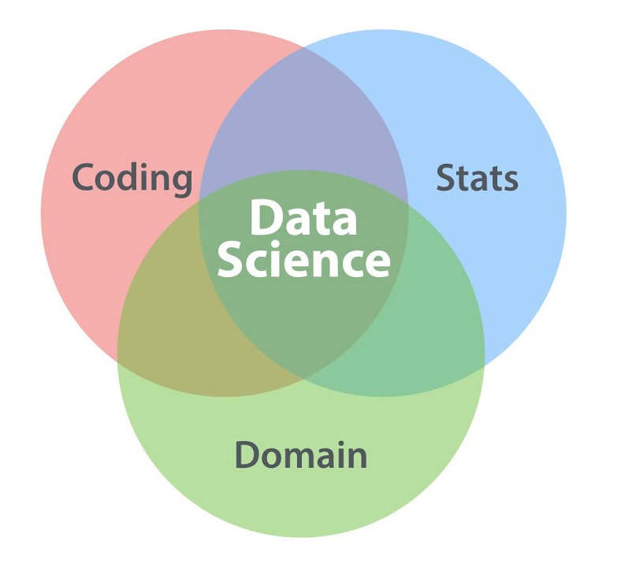
Defining Terms
Data Science Extracting insights from data using programming, statistics, and domain knowledge
Examples
Bioinformatics Creates and applies tools and algorithms to analyze biological data
mutation annotation, motif discovery, foci detection
Biostatistics Applying statistical methodology to biological research
Survival analysis,
Power calculations
Differential pathway expression,
Protein folding simulation,
Receptor/Ligand prediction
Computational Biology Using computational models to understand biology

Slide 7


Tools of the trade #1
Grad School = Being able to think critically of information
Lots of software or coding packages intended for biologists
For help with coding

Slide 8
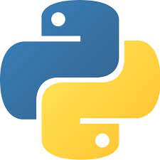

Tools of the trade #2
Workflow
Source Language: Python, R
Python, R
GUI: Jupyter Notebook,
Rstudio
Category | Excel | Prism | Python,R
Data | Intended to handle small spreadsheets/data | Intended for basic statistical analysis of data | Can handle many different forms of data (no point and click)
Figures | A few visuals are possible | Common science figures | Lots of figure options
Statistical Capabilities | Summary statistics | More common statistical tests available | Everything from basic/common to complex
Write code
Output visuals, or analysis

Slide 9
Tools of the trade #2
Source Language: Python, R
Python, R
Which should you learn?
-Python is a scripting language for complex modeling, or handling larger data sets
-R is generally better suited for visuals
GUI: Jupyter Notebook,
Rstudio
Write code
Output visuals, or analysis

Slide 10


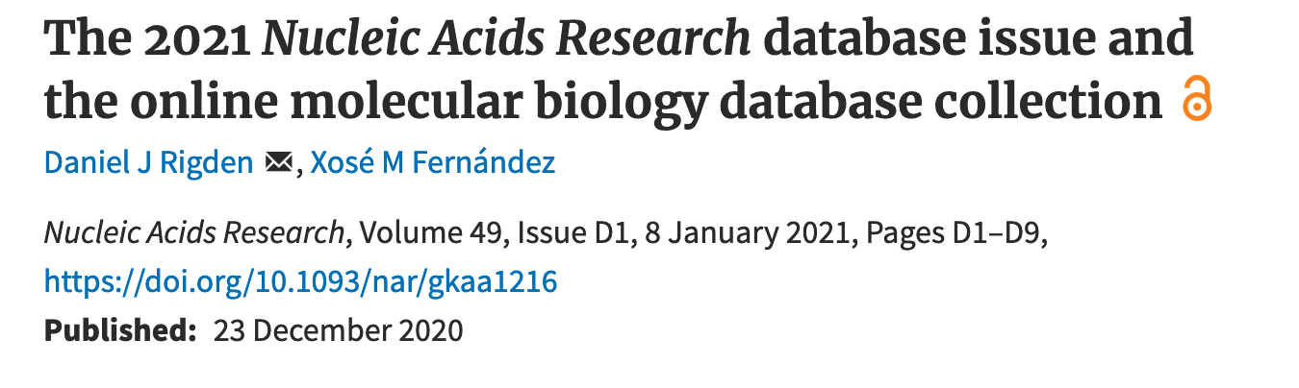

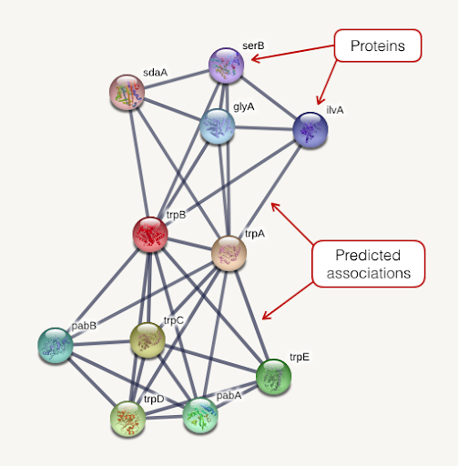


Tools of the trade #3
Online databases research specific
Looking for a database? Check NAR
If you are interested in oncology
Warning: LEARN HOW TO USE A DATABASE
THEY GENERALLY HAVE FAQ
Warning #2: DATABASES OFTEN DIE AFTER SOME TIME

Slide 11
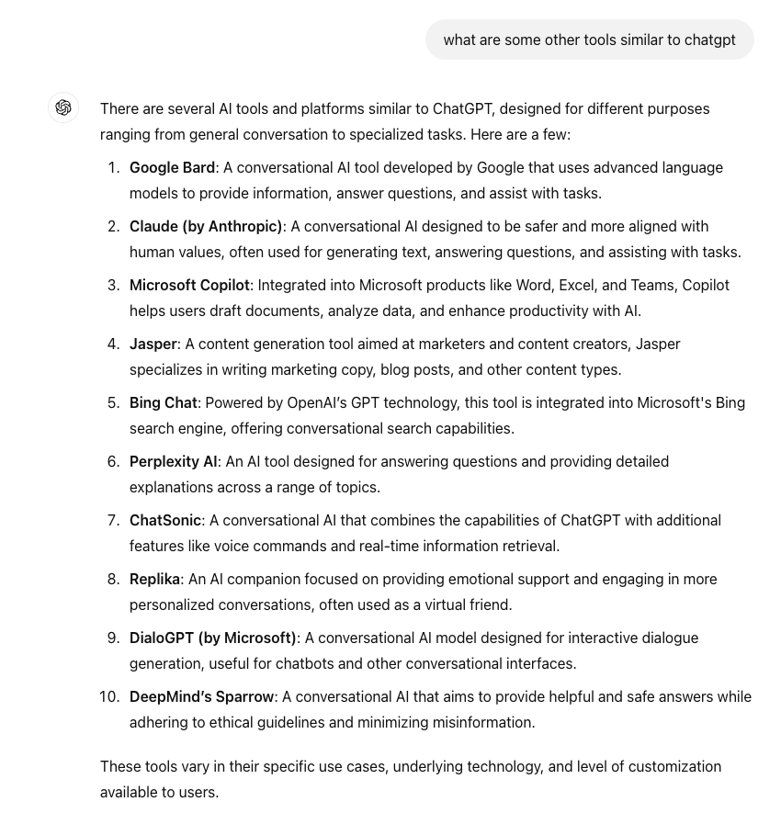
Tools of the trade #4 – AI, frequently wrong
Query pulled from ChatGPT 8/12/24,
Google Bard was rebranded as Gemini in Feb 2024

Slide 12
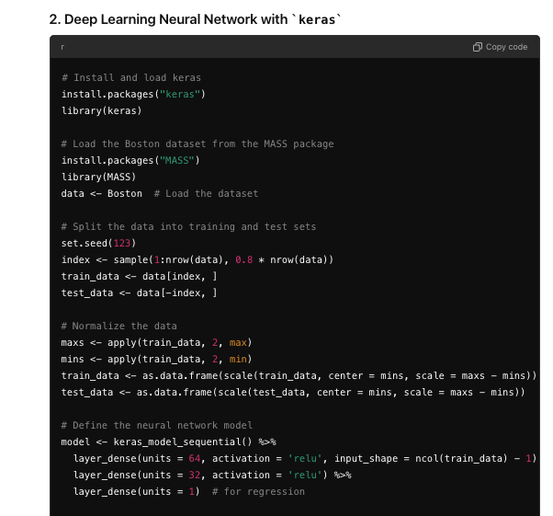
Tools of the trade #4 - AI, frequently useful
- These tools are useful for generating code.
Do not expect these tools to generate perfect code!
Its important to still understand what the code is doing.
- Grad School = Being able to think critically of information

Slide 13
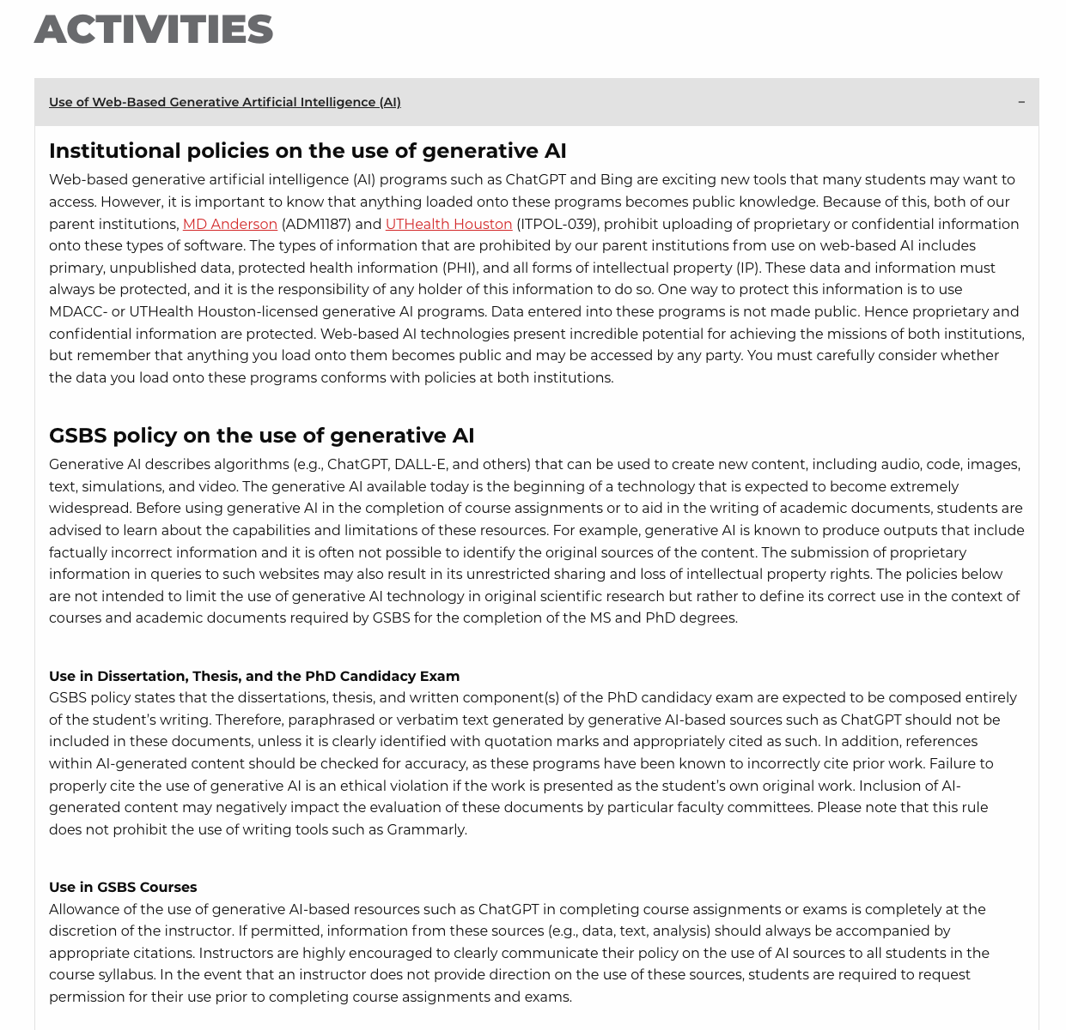
Tools of the trade #4 – AI
https://gsbs.uth.edu/academics/policies-and-procedures
Be careful with what you upload/post, especially when it comes to patient data.
Its okay to use appropriately, just be cautious.
Notes:
Be careful

Slide 14
Brief Statistics Etiquette
Important to mention topic, but please take a class if wanting to learn more.
We use statistics to answer very specific questions. Ask the question first, then incorporate the statistical test second.
What really is a p-value?
Biology always has noise, never take data quality for granted
Keep it simple
Always verify if possible

Slide 15
Break? 3-5 min? Entering ”Coding” Section

Slide 16
Graphic Literacy
Plots can get hectic and complex very quickly but remember the intended purpose of a figure is to convey a story. Ask yourself what is the author trying to tell?
A good plot will only have 2-3, rarely 4, variables at most.
To easily make visuals within R, we need to have tidy data

Slide 17
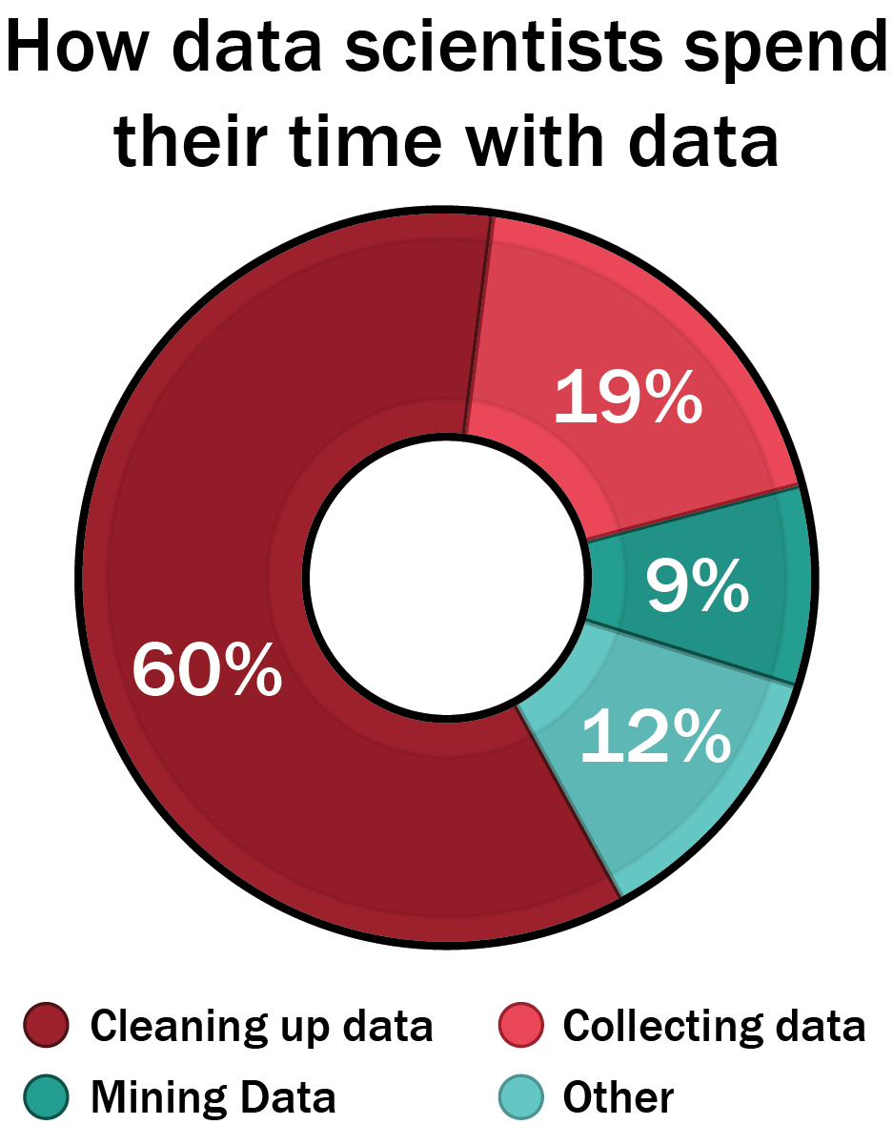
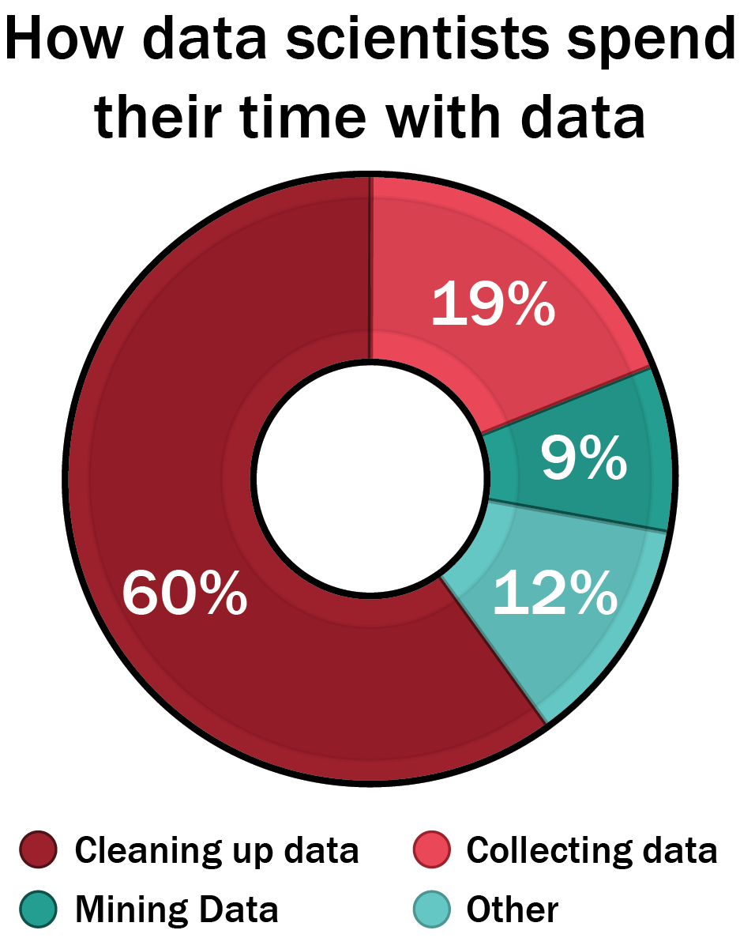
Why tidy data matters?
“Tidy datasets are all alike but every messy dataset is messy in its own way”
- Hadley Wickham
Free book R for Data Science https://r4ds.had.co.nz/
*adapted from forbes.com

Slide 18
What is messy data?
Multiple variables in a single column
Specific to coding generally
Variables expressed in both rows and columns
 | Survived |  | Died
 | Female | Male | Female | Male
Drug | 15 | 14 | 3 | 2
Placebo | 4 | 6 | 10 | 12
Messy Data

Slide 19
What is tidy data?
Single observation type per table
Each column is a variable
Patient ID | Gender | Treatment | Outcome
1 | Male | Drug | Survived
2 | Female | Drug | Survived
3 | Female | Placebo | Survived
4 | Female | Placebo | Died
5 | Male | Drug | Died
. . . | . . . | . . . | . . .
Each row is an observation
Tidy Data

Slide 20
Tools for making tidy data and nice visuals
Dplyr: R package for transforming/reshaping datasets
Command |  |  | Action
filter( ) |  |  | Select rows
select( ) |  |  | Select columns
mutate( ) |  |  | Create new columns
arrange( ) |  |  | Sort rows
summarize( ) |  |  | Calculate summary statistics
group_by( ) |  |  | Group data by a given parameter

Slide 21
What is an effective data visualization?
Always have a purpose, what is the story you are trying to tell?
https://www.youtube.com/watch?v=jbkSRLYSojo
Notes:
https://www.youtube.com/watch?v=jbkSRLYSojo good example of how data viz can be a communicator of science

Slide 22
Less is more…usually

Slide 23
Make sure the figure is worth showing

Slide 24
Avoid Pie Charts and 3D
Which section is largest? Which section is smallest?
Notes:
Pi charts hard to read, generally difficult to communicate, many instances don’t make sense

Slide 25
Avoid Pie Charts and 3D
Notes:
Pi charts hard to read, generally difficult to communicate, many instances don’t make sense

Slide 26
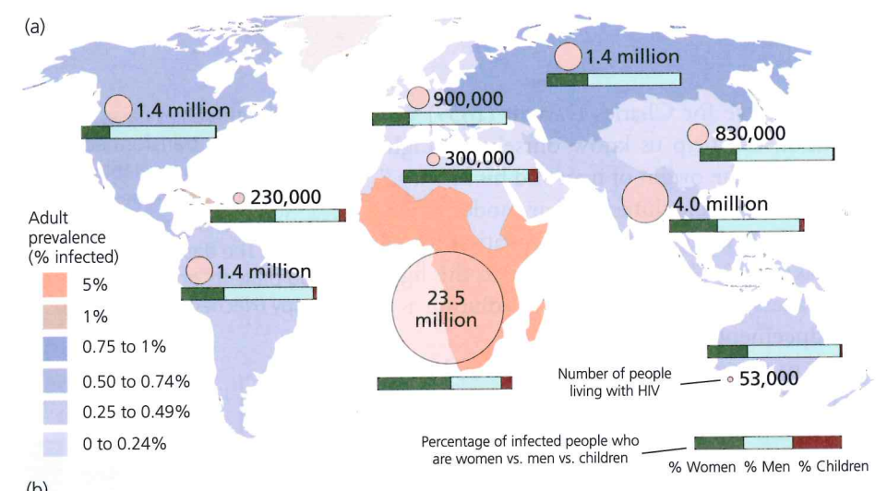
Aim for three variables, no more than four.
Notes:
how many variables is this? I count 4, location, % infected, percentage infected, and # infected.

Slide 27
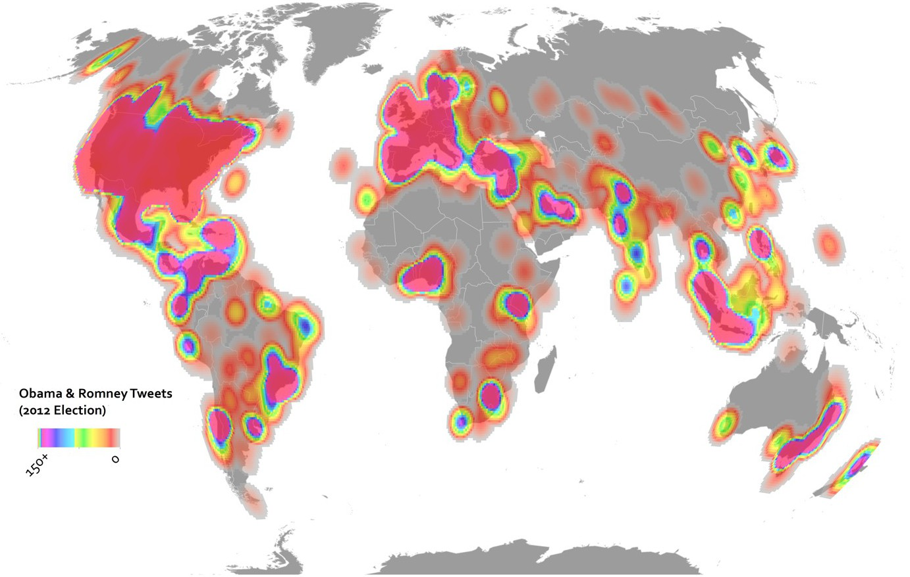
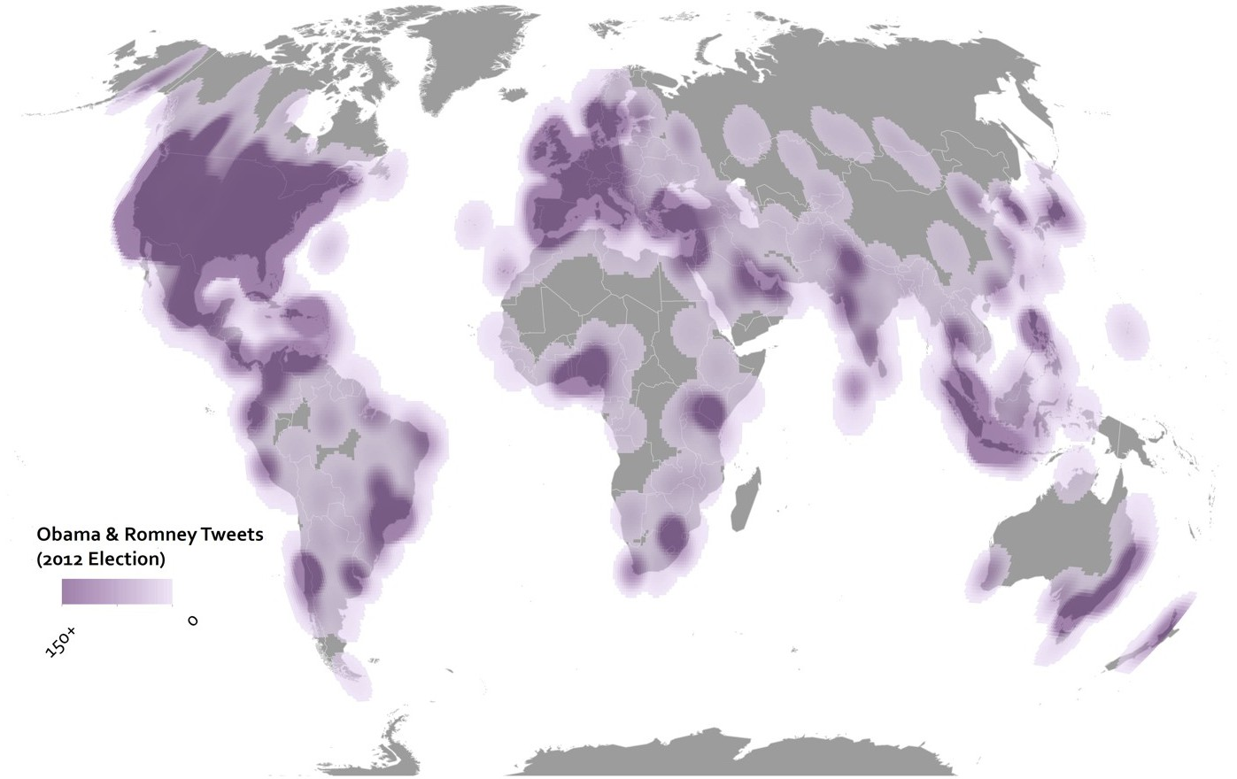
Limit the use of colors
Notes:
Try to limit color use for only variables – never for decoration, aim for clear background

Slide 28
Keep it simple
Notes:
Have things labeled, aim so that anyone could read it, keep it basic.

Slide 29
Slides and Workshop Made By Dr. Claus Wilke

Slide 30
Slides and Workshop Made By Dr. Claus Wilke

Slide 31
Slides and Workshop Made By Dr. Claus Wilke

Slide 32
Slides and Workshop Made By Dr. Claus Wilke

Slide 33
Slides and Workshop Made By Dr. Claus Wilke

Slide 34
Slides and Workshop Made By Dr. Claus Wilke
Notes:
Is this data considered tidy or not?

Slide 35
Slides and Workshop Made By Dr. Claus Wilke

Slide 36
Slides and Workshop Made By Dr. Claus Wilke

Slide 37
Slides and Workshop Made By Dr. Claus Wilke
Notes:
Incorporating all four variables into one plot.

Slide 38
Slides and Workshop Made By Dr. Claus Wilke
Notes:
Still specifying the size in the weight column

Slide 39
Slides and Workshop Made By Dr. Claus Wilke

Slide 40
Slides and Workshop Made By Dr. Claus Wilke
Notes:
Facet based on categorical

Slide 41
Slides and Workshop Made By Dr. Claus Wilke
Notes:
Same ggplot, and just change the geom type, and it changes the plot accordingly. Facet based on numeric

Slide 42
Slides and Workshop Made By Dr. Claus Wilke

Slide 43
For Future Lectures or Notes
https://wilkelab.org/classes/SDS348_spring_2020.html https://r4ds.had.co.nz/index.html
Slides and Workshop Made By Dr. Claus Wilke

Slide 44
Hands on R Workshop!

Slide 45
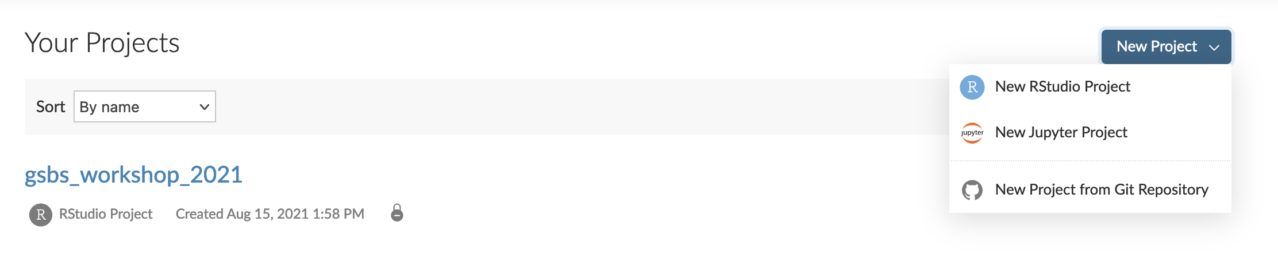
R + RStudio
The activity today will be running on R studio cloud: https://rstudio.cloud/projects
To run the activity, add a new project from Git Repo.
Add the following repo: https://github.com/aislyn/gsbs_workshop_2025

Slide 46
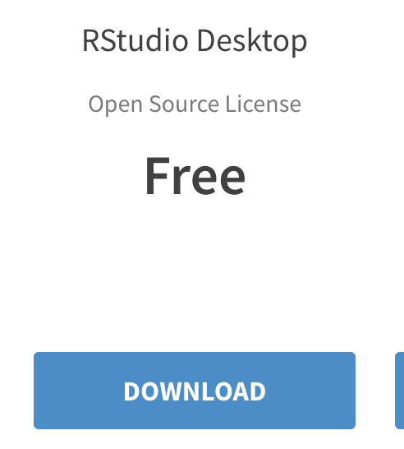
R + Rstudio Locally
If you want to run R locally you can! You just need to install both R and R Studio separately.
To install R: https://cran.microsoft.com/
To install Rstudio: https://www.rstudio.com/products/rstudio/download/
CATS (computational assistance and tutorial session) can help you as well. More info here: https://gsbs.uth.edu/quantitative-sciences/

